Slide 1


A Guide
TO SUCCESSFUL
Group Times including
TRANSITIONS

Slide 2
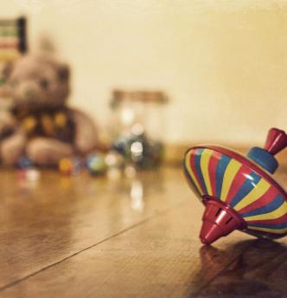
Setting up the environment to succeed
Ensure that you have adequate space for your group time. This may involve moving some furniture and equipment away that may be distracting for the children’s learning.
If separate spaces are needed for individual children, then make sure these are set up and ready beforehand. Sensory cushion, fiddle toys, sensory items for sitting etc. need to be easily accessible.

Slide 3
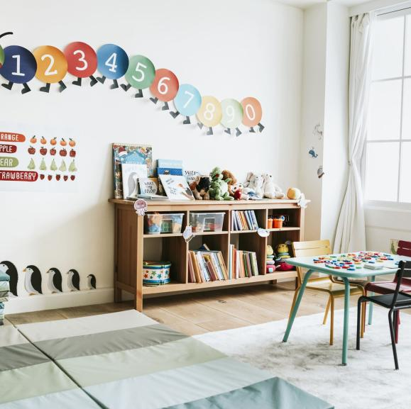
Distractions are minimal.
Ensure adjoining spaces are quiet during focused learning times .
Place a sign on room door informing educators and families to enter the learning space quietly.
Ensure all cleaning is finished prior to group time commencing. This avoids distraction but also means that educators are available to support the attention of all children during group time.

Slide 4
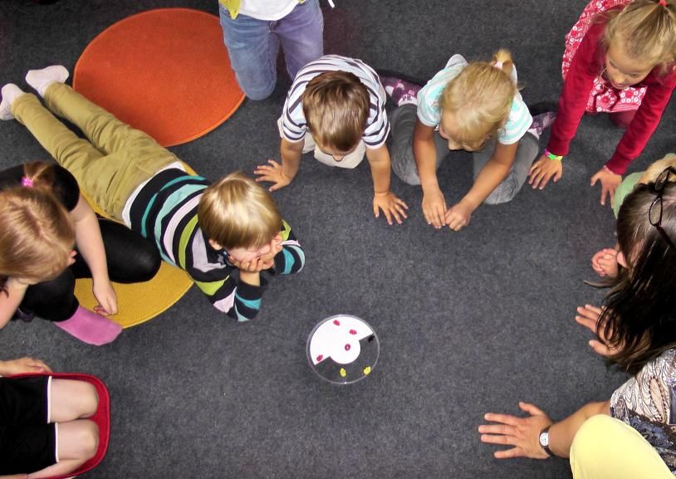
Preparation and Organisation
Ensure you have all your resources collected and ready to use before group time
Have enough resources for each child to participate
When using technology make sure that equipment is fully charged or plugged in to a power outlet, speakers are working and song, CD or video is ready to press play

Slide 5
Preparing children for transition time.
Notify
Notify children when a transition is going to happen, giving them time to prepare for the change and transition.
Use
Use a visual timer to let children know how much time is left to finish what they are doing.
Let
Let them know what is coming next (use visual schedule)

Slide 6

Gaining Children's Attention
There are many easy and fun ways of gaining children's attention.
Voice with actions - ‘waterfalls’ fingers falling (remember your expression, tone, volume)
Sound - tinkle bell, singing bowl
Sing a song with actions – ‘If you’re happy and you know it clap you hands’
Clapping rhyme -‘123, eyes on me’ (children respond ‘123 eyes on you’)
Lights off
Lights dimming while singing a slow song

Slide 7
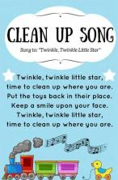
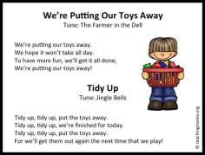
Packing Away Strategies
Teaching the children to care for & respect their play environment
Pair children to pack up an area together
Teacher quietly tells children they need to start packing up the area where they are playing.
Teacher give children specific jobs – wiping the tables, sweeping the floor, helping organise the blocks
Choose a child to take a visual around to others to let them know its time to pack up
Educator: ‘I need someone with big muscles to help’
Educator: ‘Can you tell me where this goes’
Educator: ‘Are those blocks in the right place’
Educator: ‘I wonder who could help me…..’

Slide 8
Calming strategies for regulation before or at the beginning of group time
Encourage children to have a drink from drink bottle (a short break)
Some children may need a longer break outside to run around for a while (or swings for 5 minutes)
Songs with strong beat and physical movement (marching, stamping) –‘Traveling round Australia on Highway no 1’
Singing a fast song (or rhyme) with strong beat that then slows down – ‘Dingle, Dangle Scarecrow’ or ‘Hokey Pokey’

Slide 9
Ideas for managing a large group time.
Goal - When planning group time activities try to have a goal in mind for the session and remember that children can’t sit still and concentrate for as long as we can.
Rules – When starting a large group time session always begin by reminding the children of the rules you would like to see, such as good sitting and good listening. It is always useful to reinforce these rules with picture cards or Makaton signing.
Movement Break – Children can get very fidgety if they have been sitting for a while so to try and ease this encourage the children to stand in a circle and do a little jiggle, wiggling and shaking all parts of their bodies before they sit down ready for the group time activity.
Use a Prop – Children can find it difficult if the activity involves turn taking so to aid this try using a prop or puppet to pass around the group and whoever is holding the object is the one whose turn it is to complete the activity or talk. A ball can be fun to roll around the circle to various children rather than just passing a teddy.
Make it Exciting – Wherever possible engage the children’s sense of magic, whether this be through telling a short story to set the scene for the activity or using fairy magic it’s a great way to get the children excited, listening and ready to actively participate and learn during the session.
Use Visuals – Children are visual learners.

Slide 10
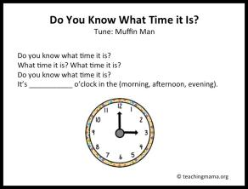
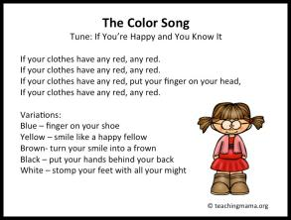
Transition Ideas

Slide 11
Group Time Calming and Regulation
Ideas
Breathing – Smell the flower, blow out the candle
Hand on heart, deep slow breathing
Squeeze your hands together
Massage hands with cream (sorbolene)
Wall or chair push ups
Crunchy snack/cold drink from drink bottle
Superman pose
Animal Walks
Yoga positions
Hand/body action songs
Soft music & movement (with scarves)
Fidget /sensory toys

Slide 12
When Speaking to Children
Engage Children by Using Your Voice with Tone and Expression
When speaking to the group it is important to vary the tone, volume and expression in your voice.
You might use a quiet voice to encourage the children to quietly listen to you.
Your voice might suddenly go up high or down low to emphasise something.

Slide 13

When Singing with Children
Children enjoy singing with educators. Be confident, no matter how you think you sound. Ensure all educators join in with you.
Use your own voice to sing and change the beat and rhythm.
As you teach children new songs develop a visual for each so that children can then choose their favourites.
Use finger puppets for finger rhymes and songs – ‘Three little speckled frogs’.
Children can take turns at acting out a song – ‘5 hot cross buns in the bakers shop’.
Rhyme and repetition of songs form an important foundation of literacy learning for children
For a demonstration of singing with children (Play School):
https://www.youtube.com/watch?v=KUUmPeAgGjw

Slide 14
 When Reading to Children 
When reading it is important to vary the pace and volume of your voice to capture the children’s attention. Ensure the book is age appropriate, visually interesting and is facing the children so that everyone can see.
Place the book on an easel so that the educator can use their hands or props to tell the story.
You can use a book to tell a story or use props to act out a story. Children can be involved in acting as characters in the story.
Rhyme and repetition of stories is an important pre literacy strategy. These form the foundation of literacy learning for children. Read favourite stories over and over again.
For a demonstration of how to read a book see:
Mem Fox – A Read Aloud Lesson
Local Author Kaye Ballie reading, ‘When the Waterhole Dries Up’

Slide 15
1. Regulation songs involving strong rhythm, big movements – allowing children to regulate and then slow and settle at the end of the song by sitting down
2. Breathing rhymes
3. Finger rhymes
4. Songs – teach new I per week and let children choose 1 song from visual of choices on wall (or easel) – sing with children
5. Visual learning time – story or experience that considers children’s capacity to attend (length of time/visual engagement)
6. Quick discussion about the learning topic/story (this can be increased as the year progresses, and children can attend for longer periods of time)
7. Review visual schedule – what is happening next – do children know what to do?
8. Ensure all educators know what their role is to support calm transitions (helping with sunscreen, toileting, etc.) and are ready
9. Dispersal of children – sing a song – ‘if you’re wearing blue today’: colours of clothes, letter of name, choose a friend, where do you live, etc.
Planning the order of a larger
Group Time

Slide 16
Tips for Successful Engagement during Larger Group times
Be mindful of the capacity of the children in the group to sit and attend
Plan a shorter group time if needed to ensure engagement
Use visuals to reinforce your teaching/story telling
Use your voice and tone to engage the children
Limit use of screens – real world engagement is best for children’s learning
If children are struggling to attend, then change – e.g. switch to talking about the pictures in a story rather than read the text
If children are showing signs of tiredness they may benefit from a short movement rhyme
Have a Plan B – if something isn’t working, change to something else or finish sooner than planned

Slide 17
Ideas to reduce children's waiting time
Ensure that children can easily transition to the next space without waiting for extended periods
Allocate a staff member to be outside to receive children in the playground
Self-help station inside and outside re sunscreen
Set up a box of books or puzzles or sensory toys for children to engage with when they need to wait for peers in an area.
Containers to set up and pack away these resources easily

Slide 18

Small Groups
Successful group times can occur indoors and outdoors with smaller groups. Think creatively. Outside, children may engage in a small group games, act out a story, help set up a play space or sit and read a story with props.
Small groups can support specific skill development of children with additional needs who may find it challenging (or overwhelming) to engage with larger groups.
Learning experiences can be set up supported by one educator and small groups of children can take turns to engage with that experience.
Quietly let specific children know that they can move to a small group experience or enter a play space where educators are supporting children to engage in learning.

Slide 19
Transitioning – lining up
(If absolutely needed)
Number off – count together how many children
Copy actions games
Pretend to be mice walking in the line
Play a guessing game
Freeze game
Simon Says
I spy …..
Regulating Sensory Input … Give yourself a squeezing hug, jumping, stretching, deep breathing etc.

Slide 20
Building Connections with Individual Children leads to Increased Engagement
Engaging with Children – Making a Connection
Sit at child’s level and follow their lead in play
Stop and listen to child
Respond to child’s ideas
Sing as you play together
Use expression to show your interest
Give some genuine positive feedback
Get to know their preferences and things they enjoy
Base learning around their interests

Slide 21
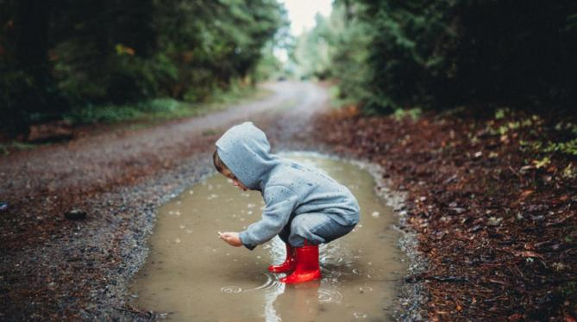

“No significant learning occurs without a significant relationship.”
By James Comer
Complied by the PSFO Team 2022

